Slide 1
Momina & Friends COS 214 Final Project

Slide 2
agenda

Slide 3
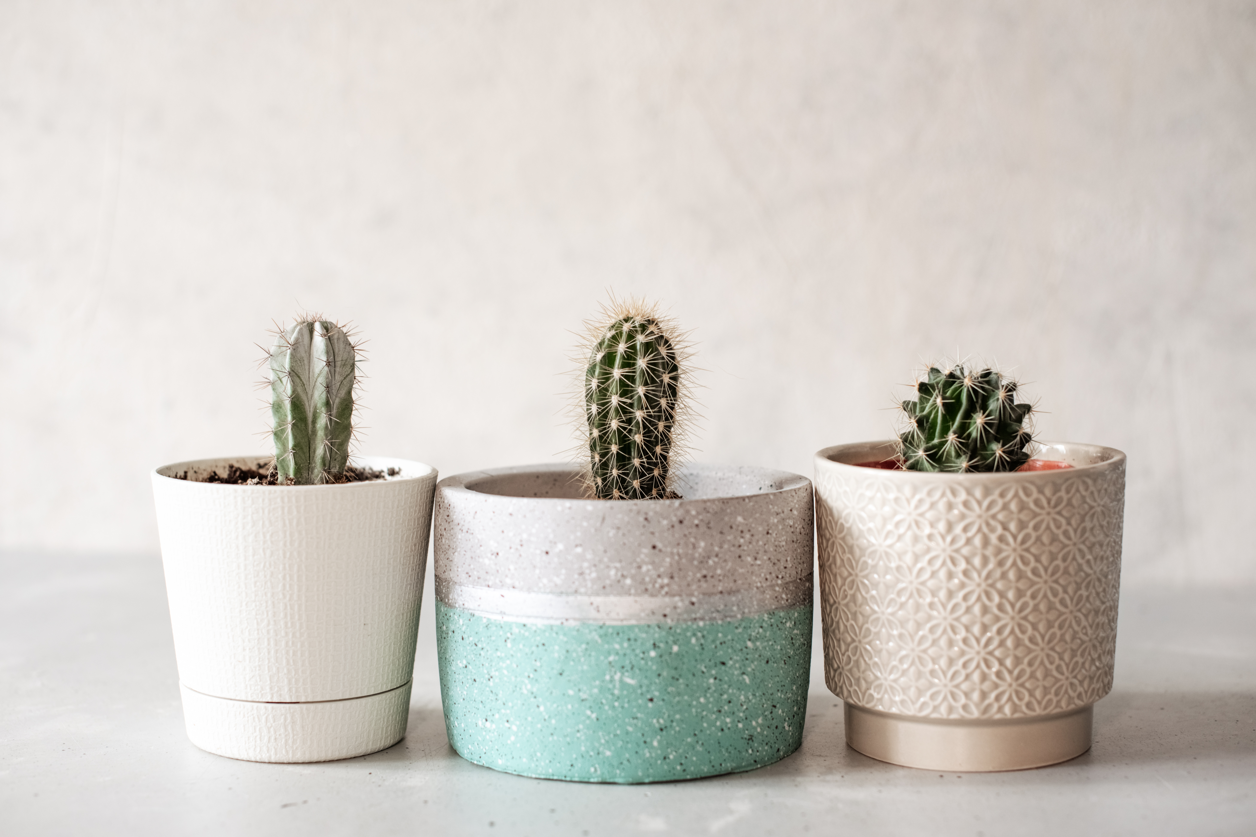
WHAT ARE WE:
Our project focuses on designing and implementing a Greenhouse Nursery Simulator — a virtual representation of a plant nursery that captures the beauty, complexity, and structure of real-world nursery operations. Inspired by the renewal and growth of spring in South Africa, the system models the interaction between plants, customers, and staff within a dynamic and evolving environment.
The aim of this project is to use object-oriented programming (OOP) and software design patterns in C++ to create a flexible, maintainable, and scalable system. The simulator demonstrates how design patterns can simplify complex problems, such as managing different plant types, handling unique care requirements, coordinating staff duties, and facilitating customer interactions.

Slide 4
Functional requirements :

Slide 5
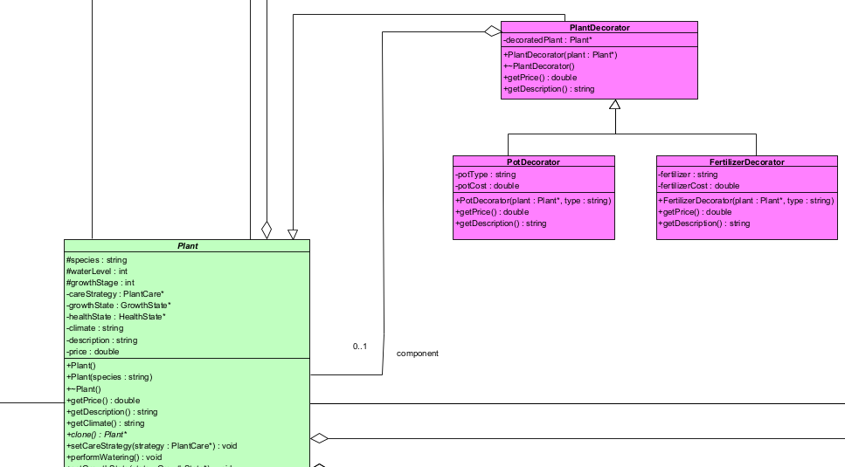
DECORATOR :
Participants :
Decorator : PlantDecorator ConcreteDecorator : PotDecorator & FertilizerDecorator Component: Plant
Functionality:
Attaches additional responsibilities to our plant object

Slide 6
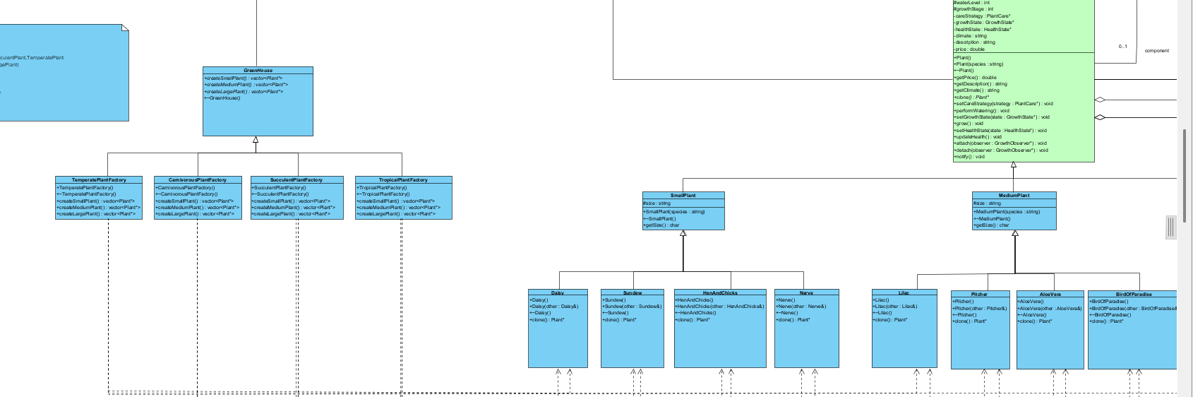
Abstract Factory:
Participants:
Abstract Factory: GreenHouse Concrete Factory: TropicalPlant, CarnivorousPlant, SucculentPlant, TemperatePlant Abstract Product: Plant(SmallPlant, MediumPlant, LargePlant) ConcreteProducts: Small: Daisy,Sundew,HenAndChick,Nerve Medium:Lilac,Pitcher,AloeVera,BirdOfParadise Large:WhiteOak,Nepenthes,Condalabra,RubberClient:Inventory
Functionality:
>Acts as an interface for all objects that depend on the GreenHouse system >Provides a common structure for plant-related classes >Allows different types of plants to be created as subclasses, ensuring organized and scalable code

Slide 7
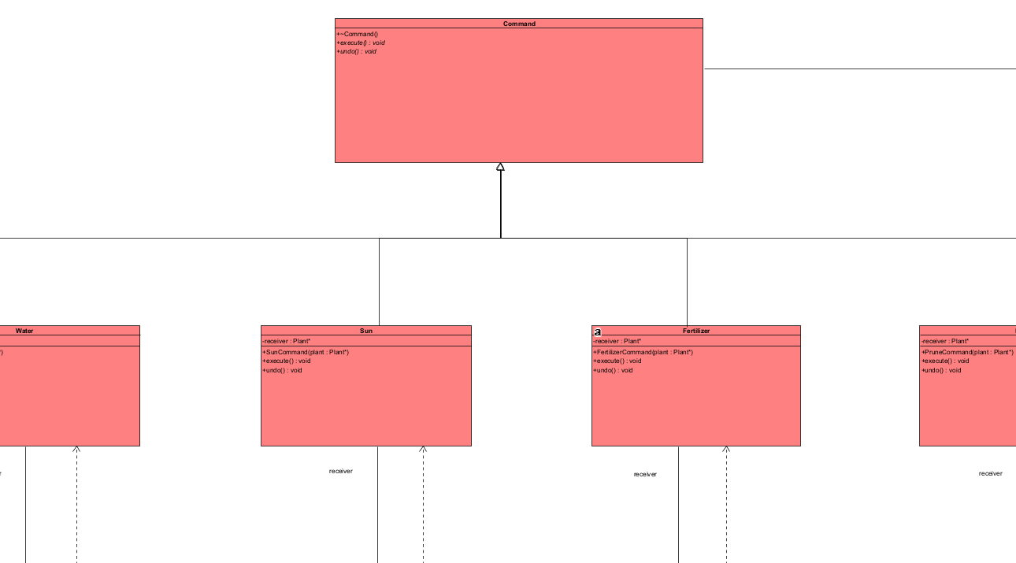
Command
Participants:

Slide 8
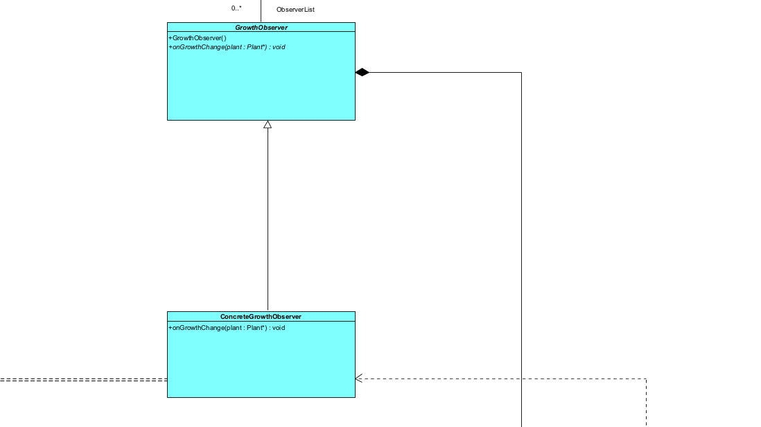
Observer

Slide 9
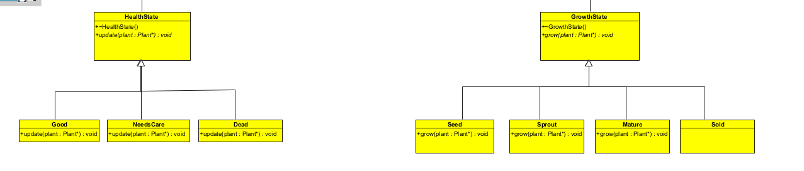
State

Slide 10
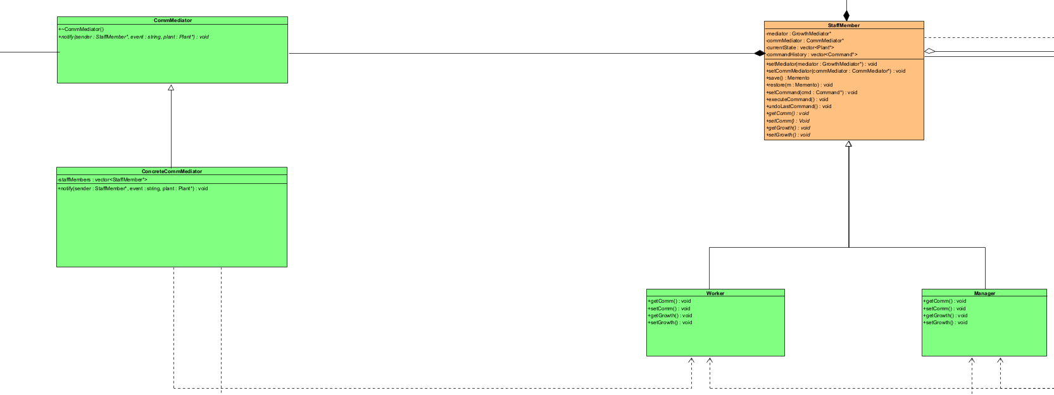
Mediator

Slide 11
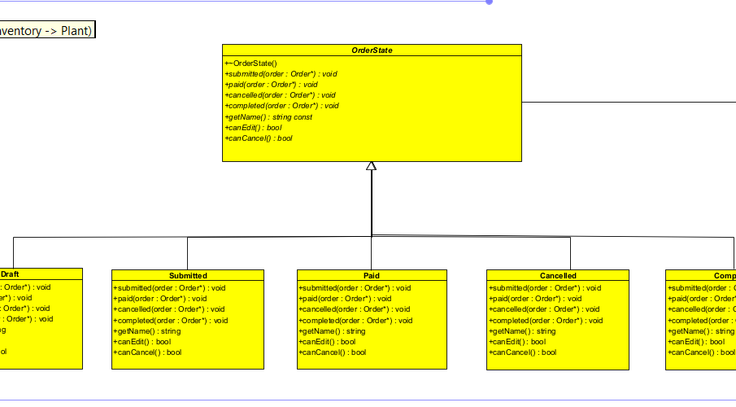
State

Slide 12
thank you
Shavir
Diya
Mahadio
Ayush
Chinmayi
Jaitin

